Slide 1
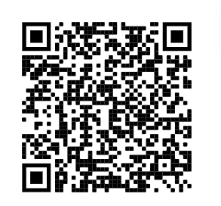
kubernetes training course – Oct 2022
author: viettq
Checkin

Slide 2
kubernetes training course – Oct 2022
author: viettq
Agenda
Review
Deployment
ReplicaSet
Working with Deployment and ReplicaSet
Practice
Summary

Slide 3
kubernetes training course – Sep 2022
author: viettq
REVIEW
Pod component: ApiVersion, Kind, Metadata, Spec
kubectl command with pod
kubectl run [pod-name] --image=[image-name] --port=[Port]
kubectl run [pod] --image=[image] --port=[Port] [--dry-run=client -oyaml]
kubectl get pods [-n namespace-name]
kubectl describe pod [pod-name] [-n namespace-name]
kubectl exec -it [pod-name] – [command] [-n namespace-name]

Slide 4
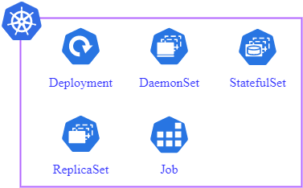
kubernetes training course – Sep 2022
author: viettq
kubernetes deployment
kubernets Workload Resource

Slide 5
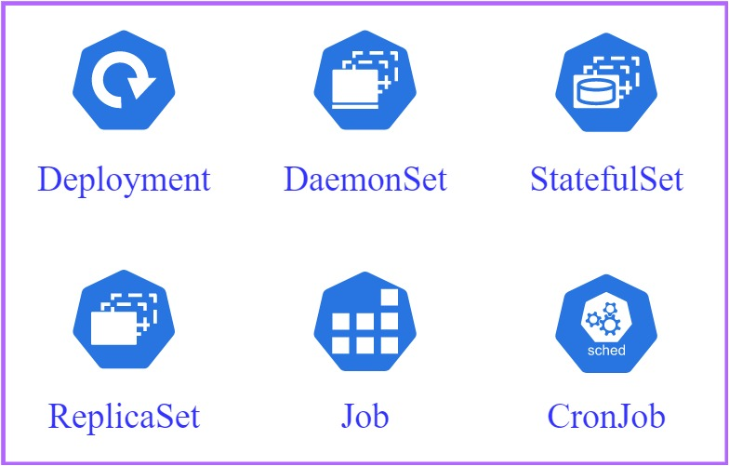
kubernetes training course – Sep 2022
author: viettq
kubernetes deployment
kubernets Workload Resource

Slide 6
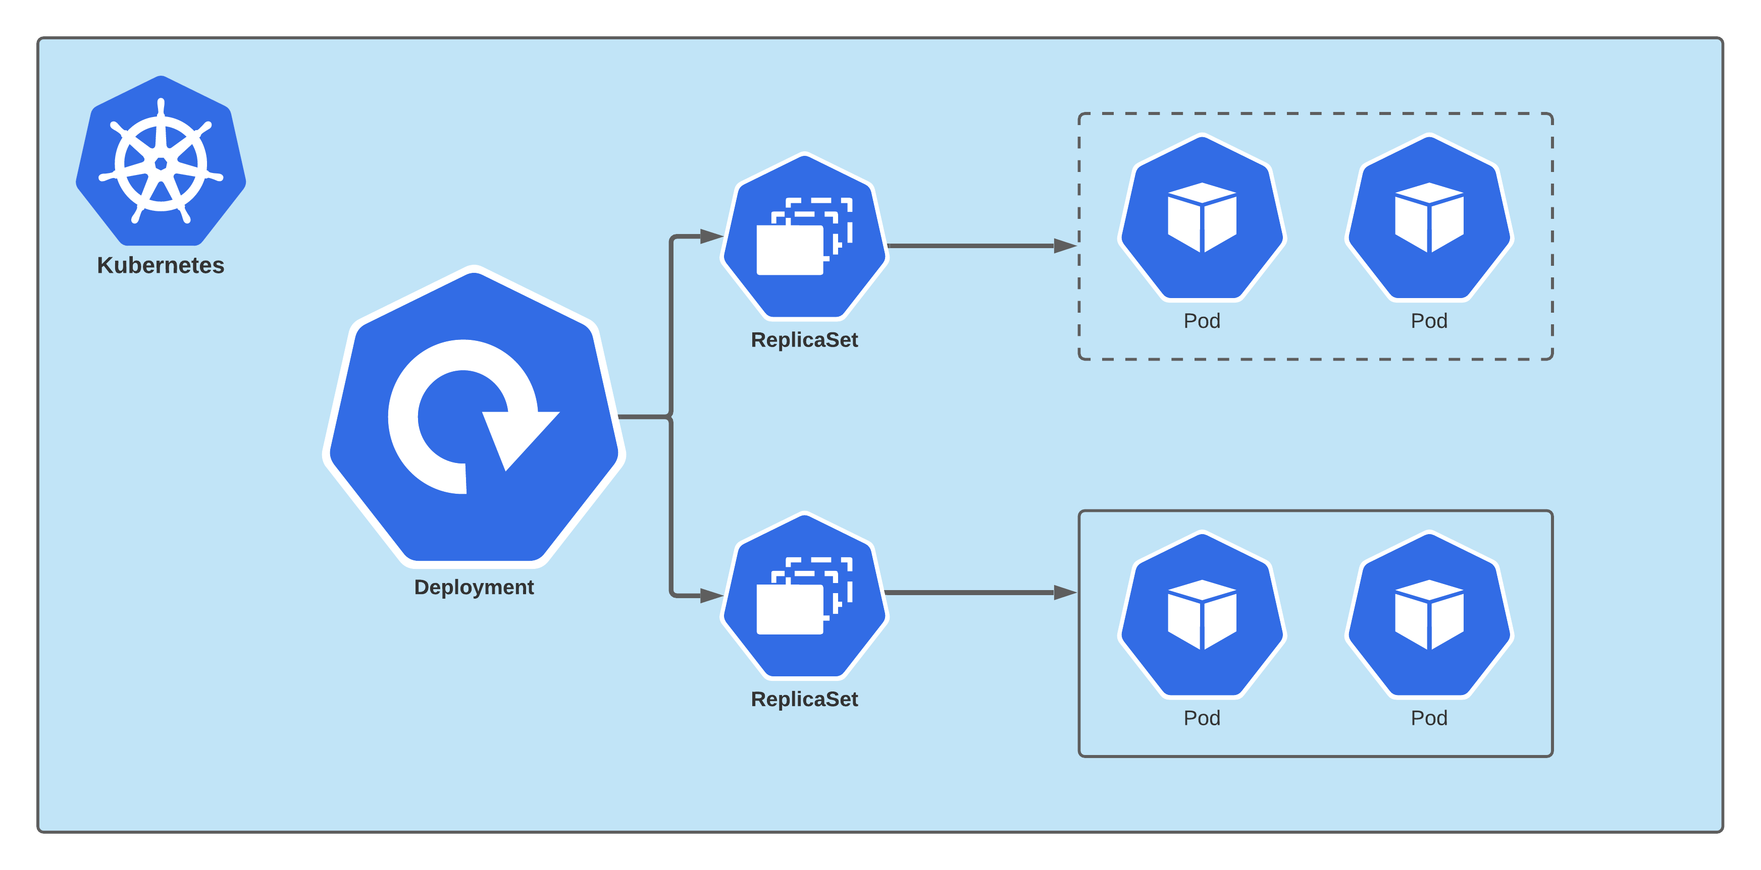
kubernetes training course – Sep 2022
author: viettq
kubernetes deployment

Slide 7
kubernetes training course – Sep 2022
author: viettq
Node ROLES
kubernetes deployment
apiVersion:
kind: Deployment
metadata: # Deployment metadata include name, labels..
spec: #Deployment spec include replicas, selector, template (pod config)

Slide 8
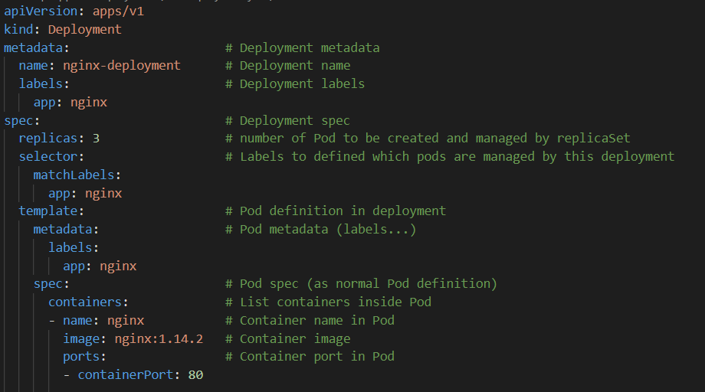
kubernetes training course – Sep 2022
author: viettq
Node ROLES
kubernetes deployment

Slide 9
kubernetes training course – Sep 2022
author: viettq
Node ROLES
kubernetes replicaset
apiVersion:
kind: ReplicaSet
metadata: # ReplicaSet metadata include name, labels..
spec: # ReplicaSet spec include replicas, selector, template (pod config)

Slide 10
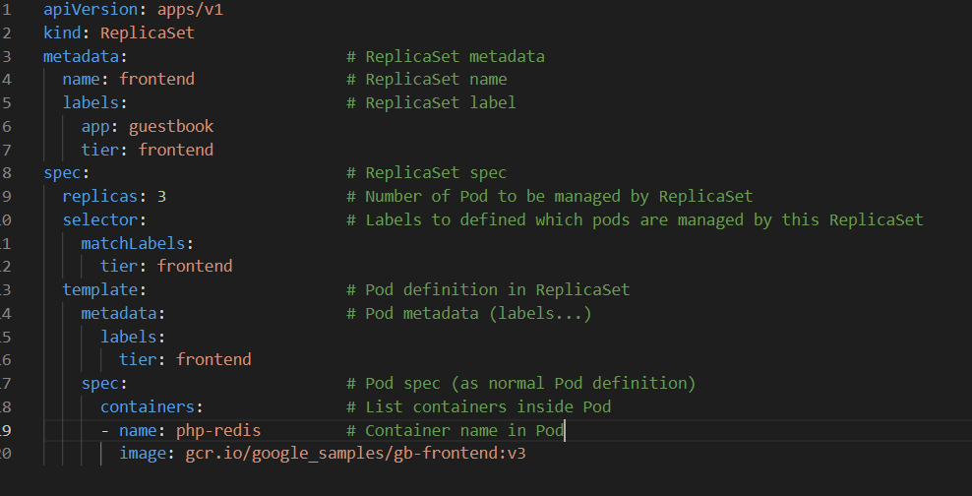
kubernetes training course – Sep 2022
author: viettq
Node ROLES
kubernetes replicaset

Slide 11
kubernetes training course – Sep 2022
author: viettq
Add/remove node
Working with deployment/replicaset
Get deployement/replicaset list
kubectl get deployments.apps [-n namespace-name]
kubectl get replicasets.apps [-n namespace-name]
Describe deployement/replicaset:
kubectl describe deployments.apps [deployments] [-n namespace-name]
kubectl describe replicasets.apps [replicasets] [-n namespace-name]
Edit deployement/replicaset:
kubectl edit deployments.apps [deployments] [-n namespace-name]
kubectl edit replicasets.apps [replicasets] [-n namespace-name]

Slide 12
kubernetes training course – Sep 2022
author: viettq
NODE STATUS
practice
Create deployment
Get deployment
Get replicaset
Get pods of deployment
Update deployment

Slide 13
kubernetes training course – Sep 2022
author: viettq
.
Q&A
Ask me anything

